Slide 1
GRADE LEVEL MEETINGS
2023-24 EXPECTATIONS
Notes:
Gilbert

Slide 2
INTROS
Welcome to the 2023-24 school year!
Administration Team
Mr. Gilbert, Principal
Mrs. Miglionico, Assistant Principal
Mr. Armour, Assistant Principal
Ms. Bass, Assistant Principal
Dr. Seabolt, Assistant Principal
Notes:
Gilbert

Slide 3
INTROS
Welcome to the 2023-24 school year!
Dean Team
Mr. Muñoz, A-D
Mr. Santiago, E-L
Mrs. Taylor, M-Re
Mr. Martinez, Rh-Z
Notes:
Gilbert

Slide 4
INTROS
Welcome to the 2023-24 school year!
Guidance Team
Ms. Lee, A-B
Ms. Vazquez, C-E
Mrs. Judge, F-I
Mrs. Ritter, J-Me
Mr. Costa, Mi-P
Mr. Bernard, Q-Sc
Mrs. Hernandez, Se-Z
Notes:
Gilbert

Slide 5
INTROS
Welcome to the 2023-24 school year!
Guidance Team Continued
Mrs. Sanchez, IB Counselor
Ms. Foncannon, College & Career Counselor
Mrs. Wiener-Long, School Psychologist
Ms. Kucukbutros, School Social Worker
Notes:
Gilbert

Slide 6
INTROS
Welcome to the 2023-24 school year!
Instructional Support & Other
Mrs. Vicens, Literacy Coach
Ms. Osborne, Learning Resource Specialist
Mrs. Callaghan, Math Coach
Mrs. Dunham, Media Specialist
Coach Boudreaux, Athletic Director
Notes:
Gilbert

Slide 7
OUR CAMPUS
Safety & Security
Lockdown Procedures & Drills
Entering and Exiting Campus in the AM/PM
Transition (directional hallways)
This is YOUR Campus
Take Care of the Facility
Clean Up and Push In Chairs in Your Area
Notes:
Bass

Slide 8
COMMUNICATION
Remind
CHS Remind: Text @sdocchlhs to 81010
Class of 2024: Text @chsstorm24
Class of 2025: Text @chsstorm25
Class of 2026: Text @storm2026
Class of 2027: Text @storm2027
Social Media
Facebook @CelebrationHighSchool
IG: @onestormnation03
Announcements
School-wide announcements
Website
Academics, Athletics, Student Services, and more
Notes:
Bass

Slide 9
LUNCH
On Campus Lunch – Where Can I Go?
Café & Outside
Clean Up
Off Campus Lunch - Starts 8/21
Juniors & Seniors Only
Applications with Mrs. Taylor (Cost is $10)
Exit between Bldg 1 & 4
Turn in Student ID when leaving campus
Students without an ID will not be allowed to leave campus
Lose ID – No Off Campus Lunch
Notes:
Taylor

Slide 10
CLUBS & ORGANIZATIONS
Clubs & Organizations
Mrs. Jacobs AVID Coordinator
Mrs. Taylor, Senior Class Sponsor
SGA Sponsor
HOCO
Campus Events
Club Organization, Interclub Council
Club Rush Days
Notes:
Taylor

Slide 11
SENIOR INFORMATION
Senior Yearbook Pictures
Insert here
Student Parking
Paperwork & Forms: A parking decal is required to park on campus. Cost is $25. A completed form along with a copy of driver's license and insurance must be turned in to Sam. Senior parking is an additional $20.
A paint day will be announced soon.
Notes:
Taylor

Slide 12
STUDENT ATTENDANCE
Daily Attendance
Attend class every period, every day
Exam Exemptions – If you have A, B, or C and have no more than 9 absences
Absences must be excused within 3 school days (provide notes to Cheryl Vicari in front office or email to clhsattendance@osceolaschools.net)
Notes:
Martinez

Slide 13
TARDY POLICIES
Tardy to School Details
7:15-7:25 – Students late to school will report to student services to receive their tardy to school pass and then report to class.
7:26-End of 1st Period – Students arriving to school during this time will enter through the front door of the school. They will be marked as an “I” (In-School Suspension) in Focus and will not be allowed to go to first period. They will hold in 2-101.
2nd-7th Period Tardies – All students tardy to school during these periods will also enter through the front door of the school. Students who arrive to school within the first 5 minutes of the period will be given a tardy pass and be allowed to go to class. All students who arrive after the first 5 minutes of a period will have to hold in 2-101 until the next period and be marked as “I” in Focus.
Any student who is held in 2-101 due to a tardy is responsible for all work missed from the teacher for that period. Unless otherwise noted by the teacher, all work is due the following school day.
Notes:
Martinez

Slide 14
TARDY POLICIES
Tardy
Tardy to School – Scan your ID and get a pass from student services
Tardy to Class – Get a pass from administrator or dean, which will have handheld devices, or from student services
3 Tardies = 1 Absence
Hall Passes
Hall Pass must be with you anytime you are not in class
Notes:
Martinez

Slide 15
TARDY POLICIES
Tardy to Class Details
Any student who is tardy to class will be required to obtain a tardy pass from a member of the leadership team throughout campus OR report to student services to receive a tardy pass. Any student who is more than 5 minutes late to class will be required to report to 2-101 for the period and be marked as “I” in Focus.
Any student who is held in 2-101 due to a tardy is responsible for all work missed from the teacher for that period. Unless otherwise noted by the teacher, all work is due the following school day.
Notes:
Martinez

Slide 16
TARDY CONSEQUENCES
For students who are tardy but are within the threshold to be eligible to still go to class, the following progressive discipline will be followed:
1st Period Only:
Tardies 1-3 = Warning and go to class
Tardy 4 = Call home to parent/guardian
Tardy 5 = In-School Suspension (ISS)
Tardy 6 and beyond = Out of School Suspension (OSS)
Tardy counts will reset each semester.
Periods 2-7
Tardies 1-3 = Warning and go to class
Tardies 4-6 = Lunch Detention
Tardies 7-9 = Wednesday Detention
Tardies 10-12 = In-School Suspension (ISS)
Tardies 13-15 = 2 Days of In-School Suspension (ISS)
Tardies 16 and beyond = Dean/Admin Discretion / Out of School Suspension (OSS)
Notes:
Martinez

Slide 17
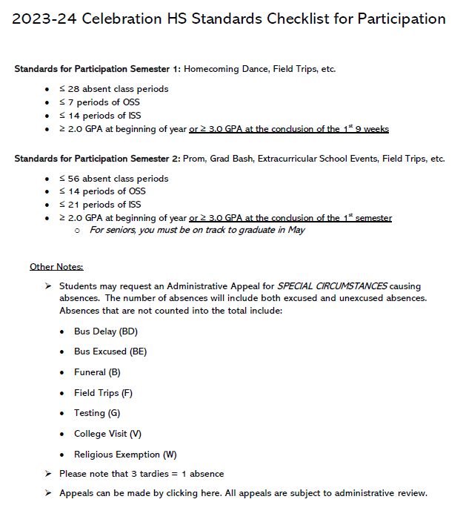
STANDARDS OF PARTICIPATION
Notes:
Munoz

Slide 18
OUT OF CLASS
Hall Passes
Hall Pass must be with you anytime you are not in class
Bathroom Passes
Bathroom Passes (colored lanyard with pass) must be with you anytime you visit the bathroom
10/10 Rule
Not leaving class during the first 10 or last 10 of any period
Notes:
Munoz

Slide 19
TRANSPORTATION
Bus Pass Process
Change of address: Need 2-3 days to complete, Guidance or Student Services
Emergency: Request made prior to lunch in Student Services
End of Day Departure Procedures
Bus riders: Read the board by cafeteria doors and have ID ready
Car riders: Be ready in front of Administration building
Walkers/Bike riders: Exit through main gate or pedestrian walkway by bus exit
Student Parking
Paperwork & Forms: A parking decal is required to park on campus. A completed form along with a copy of driver's license and insurance must be turned in to student services.
Notes:
Muñoz

Slide 20
STUDENT APPEARANCE
Student IDs
Must always be visible
Tops:
Polos: Black, white, blue, purple, or grey​
CHS Spirt Shirt
Bottoms:
Blue, black, or khaki​ pants, shorts, or skirts
*Jeans are okay
Wednesdays - College or military shirt (not just camo)​​
​
Notes:
Santiago

Slide 21
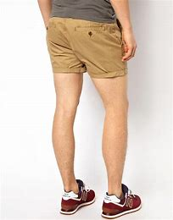
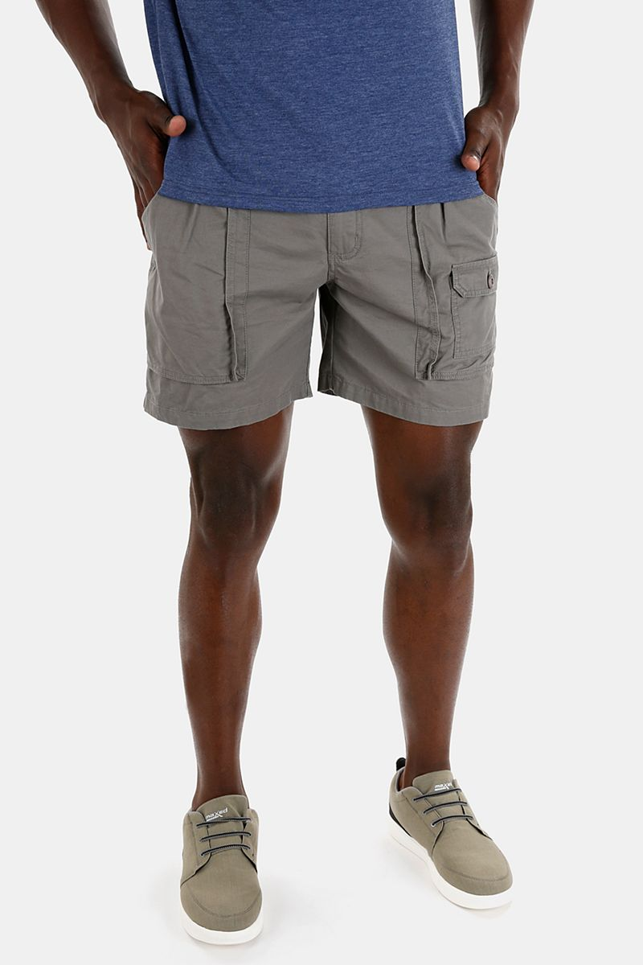
STUDENT APPEARANCE
No undergarments showing.
No crop top/stomach showing.
No shorts above mid-thigh.
No skin above mid-thigh.
No sagging pants.
No hats/bandanas/hoods
No inappropriate logos/designs
No sweatpants/pajama pants
No plaid/patterns
No non-approved shirts over approved shirts
CONSEQUENCES
Parents will be notified, and student will be sent to ISS until the dress code can be corrected.
On the 8th Dress Code Violation (DCV), Out of School Suspension will be administered.
Notes:
Santiago

Slide 22
ATHLETICS
Athletics
Coach Chad Boudreaux
Athletic Director
30 sports
Eligibility
2.0 Unweighted GPA
Packet
Aktivate
Physical (Dated and Doctor Stamp)
ECG (one time)
Impact Test
Notes:
Boudreaux

Slide 23
MEDIA CENTER
Procedures
Book Check-Out
Have Student ID
Obligations
Times to Visit
Lunch
Battle Of The Books
Notes:
Jackie

Slide 24
GUIDANCE INFORMATION
Schedule Changes
No new requests
Final requests will be completed today
Credit Checks/Graduation Requirements
Seniors – begin toward end of August
All other grade levels will be scheduled in September
Counselor Appointments
Open office hours during both lunches
Bookings Links – posted in classrooms and CHS website
Notes:
Miglionico

Slide 25
TECHNOLOGY
School Techs
Yurk Munoz-Pavon
Ceci Coello Amado
Technology Responsible Use
Appropriate Use // Keystrokes
Potential Discipline
Tech Support
Lunch
Notes:
Armour

Slide 26
ELECTRONICS POLICY
Background
House Bill 379 lines 211-215 state, “a student may not use a wireless communications device during instructional time, except when expressly directed by a teacher solely for educational purposes. A teacher shall designate an area for wireless communications devices during instructional time.”
Notes:
Seabolt

Slide 27
ELECTRONICS POLICY
Background
House Bill 379 lines 211-215 state, “a student may not use a wireless communications device during instructional time, except when expressly directed by a teacher solely for educational purposes. A teacher shall designate an area for wireless communications devices during instructional time.”
For Osceola, all devices must remain powered down, silenced, and stored out of sight during school hours.
Notes:
Seabolt

Slide 28
ELECTRONICS POLICY
Consequences
1st Infraction: Confiscation of device through the end of the day (minor infraction)
2nd Infraction: Confiscation of device requiring parent pick up (minor infraction)
3rd Infraction: Confiscation of device requiring parent pick up and parent conference on day of pickup (minor infraction)
4th Infraction & Beyond: Confiscation of device requiring parent pickup and 1 day of Out of School Suspension the following day of school (referral)
Notes:
Seabolt

Slide 29
ELECTRONICS POLICY
Consequences
Refusal to turn in a device for confiscation, or deliberately misleading a school administrator by turning over a prop phone, once a violation has occurred, will be treated as insubordination and subject to discipline and a written referral. For this, the following discipline progression will be followed:
1st Infraction: Confiscation of device requiring parent pick up and 1 day of In School Suspension the following day of school (referral for insubordination)
2nd Infraction & Beyond: Confiscation of device requiring parent pickup and 1 day of Out of School Suspension the following day of school (referral for insubordination)
Notes:
Seabolt

